Slide 1
Regional anesthesia and analgesia
Klinika anesteziologie, resuscitace a intenzivní medicíny
Univerzita Karlova, Lékařská fakulta v Hradci Králové
Fakultní nemocnice Hradec Králové
Dept. of Anaesthesiology and Intensive Care Medicine
Charles University, Faculty of Medicine
University Hospital Hradec Kralove
Notes:
Dear students, I am doctor David Astapenko and I will guide you through this presentation which is about regional anesthesia and analgesia.

Slide 2
Regional - Local anesthesia
Local anesthesia (LA)
consciousness preserved if not used as a part of combined anesthesia together with general anesthesia
anesthesia limited to a certain body region (area)
patency of airways and protective reflexes preserved
topical,
infiltration,
regional (peripheral and central blocks)
Notes:
Anesthesiologists use basically 2 types of anesthesia. General anesthesia is done by injecting or inhaling chemical angents – anesthetics and they act in the brain areas of consciousness and thus affects the whole organism not only by unawareness. In case of regional or local anesthesia the consciousness is basically preserved´unless sedatives are used concomitantly. Anesthesia is limited to a specific area of the body or region. The airways are patent and protective reflexes intact.
We differentiate topical anesthesia, infiltrational anesthesia and regional anesthesia – peripheral nerve blocks and central blocks or so called neuraxial anesthesia.

Slide 3
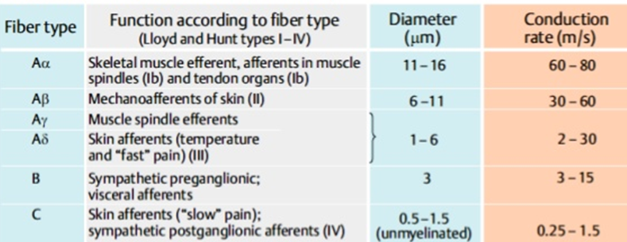
Nerve fibres
A – myelinised somatic fibres
B – myelinised preganglionar vegetative fibres
C nonmyelinised fibres
Conduction of pain
Rapid system - A fibres
Slow system - C fibres
Notes:
In regional anesthesia chemical agents called regional anesthetics which are derivates of cocaine are used to blunt the conduction in nerve fibres. Nerve fibres to be blocked are myelinised somatic A fibres that conduct sharp acute pain in a rapid system; myelinised preganglionar vegetative B fibres and nonmyelinized C fibres that conduct long lasting dull pain in slow system.

Slide 4
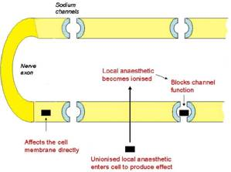
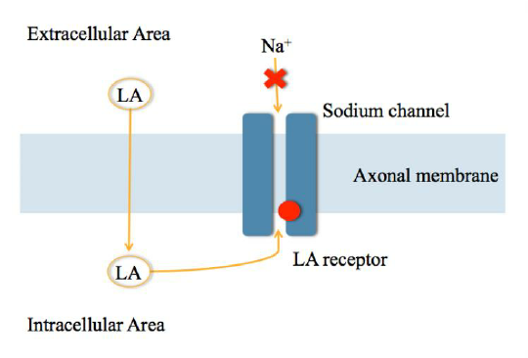
Local anesthetic agents
Drugs, that block the generation and propagation of impulses in excitable tissues
Mechanisms of action
prevention of increasing permeability of neural membrane to Na+ ions as the main mechanism of „local anesthetic“ activity
stabilising and maintaning Na channels in inactive state
Notes:
Local anesthetisc block the generation and propagation of impulses in excitable tissues. They prevent the increase in sodium ions permeability in neurons. They also stabilize and maintain the Na channels within the inactive state.

Slide 5
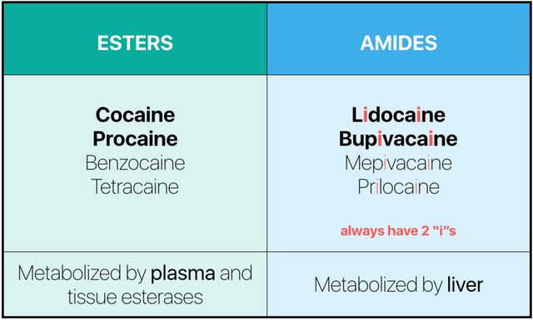
Two main groups of local anestehtics
Notes:
Local anesthetics are separated in two main groups. Esters and amides. Esters are close derivates of cocaine. They contain esteric bond and due to this they are metabolized by plazma and tissue enzymes esterazes and so the action is relatively short. The are also prone to precipitate alergic reaction more often then the other group. Esters are used less often nowadays. Beside cocaine there is procaine, benzocaine, chlorprocaine and tetracaine in the group.
The other group are amid LA. They containe amide bond in the molecule and so they are to be metabolized in the liver by microsomal hepatic system and so their action is longer then esters. They are used the most nowadays. The most used ones are lidocaine (or in Czech Republic trimecaine), bupivacaine, levobupivacaine, mepivacaine and prilocaine.

Slide 6
Local anesthetic agents
Esters
2 chlorprocain (1%)
procaine (1-10%)
tetracaine (2-0,5%)
Notes:
Ester´local anesthetics are 1% chlorprocaine, 1-10% procaine and 2-0,5% tetracaine.

Slide 7
Local anesthetic agents
Amides
lidocaine (0,5%-5%) 500 mg max. dose
prilocaine
levobupivacaine
bupivacaine (0,25-0,5%) 200 mg max. dose
etidocaine
ropivacaine
Notes:
Amid local anesthetics are lidocaine 0,5-5% in a maximal daily dose 500mg. Prilocaine, levobupivacaine, bupivacaine in 0,25-0,5% solution with the maximum dail dose of 200mg. Etidocaine and ropivacaine.

Slide 8
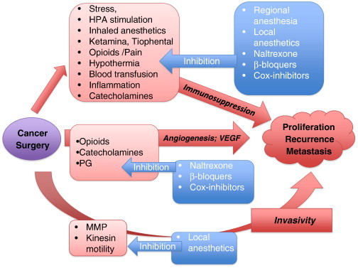
Mechanisms of action of local anesthetics
Na+ channels -- main „local anesthetic“ mechanism
K channels
Ca channels
Receptors
Muskarine, nikotin, beta –adrenergic …
Enzymes
Mitochondrias
Ovlivnění dýchacího řetězce
Leukocytes
Trombocytes
Notes:
Local anesthetics block many channels and cellular enzymes but the most pronounced action is the sodium channel block which produce the actual ánesthesic mechanism. They also block potassium and calcium channels. Also some cellular receptors: muscarinic, nicotine, beta adrenergic. Mitochondrial respiratory chain. ´They also influence the action of leukocytes and thrombocytes.

Slide 9
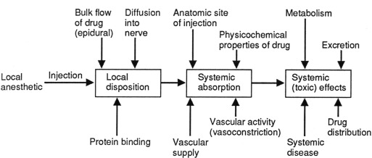
Farmacokinetic of local anesthetic
Notes:
As for pharmacokinetics, LA are injected usually to the close proximity of the desired nerve or region and they act locally. Then they are absorbed into the circulation based on the vascular reactivity and physiochemical properties. Finally they are metabolized and excreted.

Slide 10
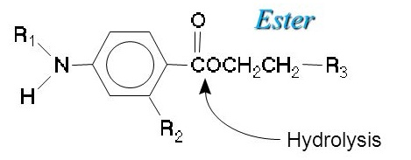
Metabolism of local anesthetic
Esters
Esterase ( pseudo cholinesterase)
Inactive products of hydrolysis
Amides
Liver (cytochrom P 450)
Active metabolites
Urinary excretion
Notes:
Again to the metabolism, esters are hydrolyzed with pseudocholinesterase in the blood and in tissues with non specific tissue esterases. They are hydrolyzed into inactive products. On the other hand, amids are metabolized in the liver by microsimal komplex cytochrom P 450 nad they have active metabolite that are excreted by urine.

Slide 11
Complications of regional anesthesia
Allergy to local anesthetics (Esters LA - parabens)
Systemic toxicity of local anesthetic
Good dose to vein or artery (intravasal)
Bad dose to right place (high absorption to circulation – toxic plasma concentration of LA)
Tachyfylaxis
Decrease of pH
Infection (local – in the needle point , neuroinfection)
Hemorghage
Nerve damage (needle, position damage)
Notes:
Regional anesthesia is not free from side effects. The most common is allergic reaction. Then based on systemic concentration toxic reactions. This can be also achieved by inadvertent intravascular injection. Other type of complications are: tachyphylaxis, infection in the place on skin/mucosal puncture, hemorrhage or nerve damage eighter by a needle of by neurotoxicity of local anesthetics.

Slide 12
Allergic reaction - LA?
Notes:
Although allergic reaction are most common they are often missdiagnosed instead of vasovagal syncopy from anxiety, idiosyncrastic reaction, intravenous application with epinephrine. There is not a cross reaction between the 2 groups of LA.

Slide 13
Local anesthetic agents – side effects
Systemic toxicity (LAST)
(excessive plasma concentration of LA)
Local neurotoxicity (in the place of administration)
Allergic reactions (esters more than amides)
Specific side effects
(Prilocain methemoglobinemia – need to administer more than 600mg for adult, Ther.: methylene blue)
Notes:
This slide is to recapitulate side effects. Please note also the last gropu – specific reactions like methemoglobinemia with excessive dose of prolocain.

Slide 14
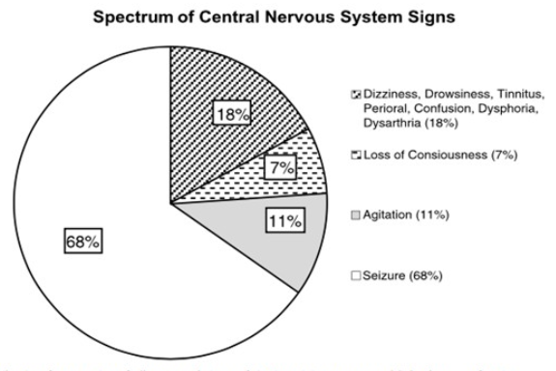
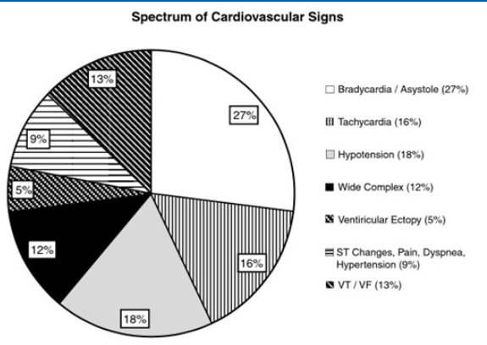
Systemic toxicity of LA (LAST)
CNS toxicity:
dizziness, dysarthria, tinnitus,
paresthesia, fasciculations,
seizures, coma
Causes:
- excessive dose of LA given to correct site
- correct dose of LA given IV, IA
Notes:
Systemic toxicity of LA is based of the systemic concentration. It is cause by excessive dose of incorrect site of application – intravenously/intraarterialy. The syndrom first starts with central nervous systém symptom like dizziness, dysarthria, paresthesias and can go up to the seizures and coma. The the cardiovascular toxicity ensues from blocade of potassioum and calcium channels in the heart and vascualture. Arrhythmias, heart blocks or even cardiac arrest can occur.

Slide 15
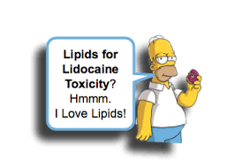
Therapy of systemic toxicity
Stop further application of LA
Oxygenotherapy
Anticonvulsants
- Diazepam 5 - 20 mg iv
- Thiopentone 100 - 150 mg iv
CPR
Adrenalin
Atropin
Efedrin
Defibrillation, cardioversion
IV lipids, ECMO
Notes:
So for the therapy, LA are to be discontinued, give oxygen and symtomatical therapy with anticonvulsants. In case of cardiac arrest start CPR. Rescue therapy is lipid emulsion intravenously as soon as possible in bolus dose of 1,5ml of 20% lipid emulsion intravnously. The ultimum refugium therapy is extracorporeal membrane oxygenation in a veno-arterial setup.

Slide 16
Prevention of systemic toxicity
Do not exceed recommended doses
Aspiration before application for prevention of IV injection
Test dose
Slow application (max. 10 ml/min.)
Verbal contact with the patient during application of LA
Notes:
In a prevention of systemic LA toxicity you should never exceed the maximum recommendation dosage. Before application aspiration to preven intravascular bolus. You can use test-dose, slow applicaton and keep on verbal contact with the patient.

Slide 17
Regional anesthesia techniques
sole anesthestic technique
in combination with sedation or GA
providing postoperative analgesia
general contraindications
allergy to local anesthetic agents
infection at the site of block
coagulopathy
patients refusal
Notes:
Now let me talk about regional anesthesia techniques.
They can be used as a sole anesthetic technique of in combination with periprocedural sedation or concomitant to the general anesthesia. It can be also used as a postoperative analgesia.
Contraindications are: allergy to local anesthesics, infection at the site of intended block, coagulopathy and patient refusal.

Slide 18
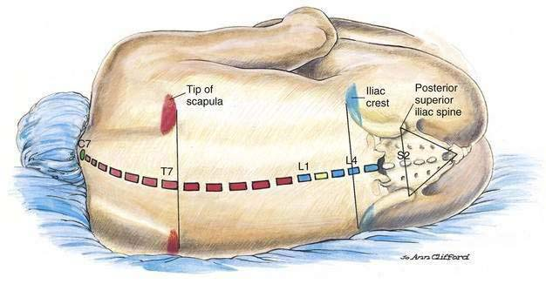
Central - neuroaxial blocks
Subarachnoideal anesthesia
Spinal anesthesia
Epidural anesthesia
Cervical
Thoracic
Lumbar
Caudal
Notes:
Lets start with central blocks, so called neuroaxial blocks. These are done by LA injection into the spine in a close proximity to the spinal cord.
By injecting LA beneath the arachnoidea the patient will have subarachnoideal anesthesia or so called spinal block.
Epidural anesthesia is to be idone by injection of LA in fron of the spinal dura mater. We use this technique in thoracic, lumbar, caudal and cervical region.

Slide 19
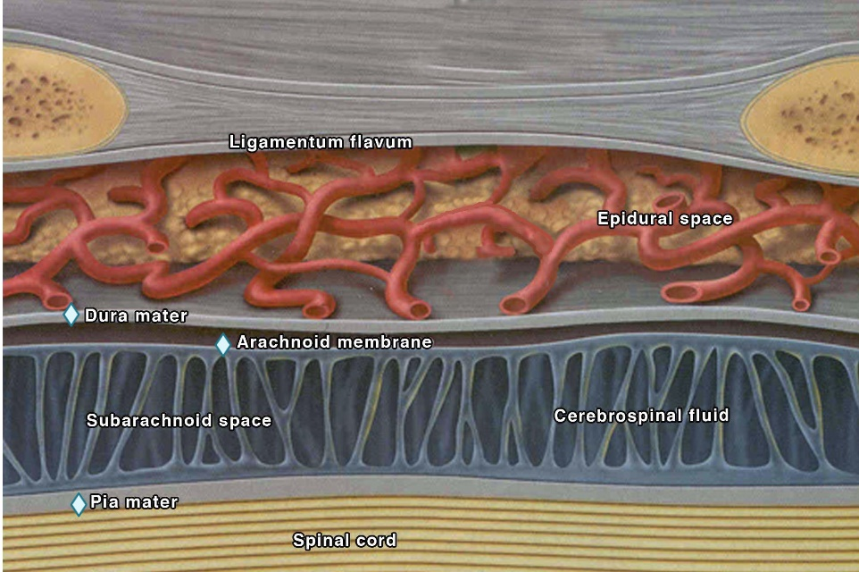
Notes:
A detailed anatomy of the spinal cord envelopes. From the top you see ligamentum flavum with elastic fobres, then epidural space with fat tissue and epidural vein plexes, dura mater and arachnoiea, subarachnoid space with cerebrospinal fluid, pia mater and spinal cord itself.

Slide 20
Epidural and spinal anesthesia
Indications
modification of the perioperative stress response
benefit of awake patient
postoperative pain management (epidural)
pre-emptive analgesia (prevention of phantom limb pain)
effect on spinal roots
Notes:
The advanteages of neuraxial anesthesia are to modify perioperative stress response, to keep the patient conscious, to facilitate postoperative pain management, to start preemptive analgesia (e.g. To limit phantom limb pain in amputation surgery).

Slide 21
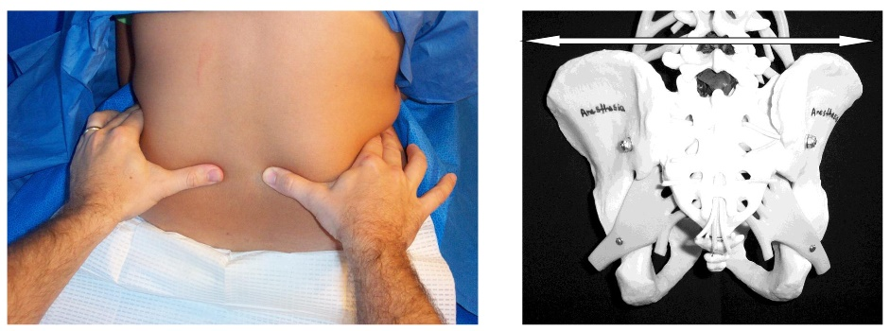
Tuffier´s line L4 or L4/5
Notes:
On this slide you can see the technique of palpation the Tuffiers line to find lumbar vertebra 4 and intervertabra lspace L4/5. By this technique we count the vertebrae and look for optimal puncture site.

Slide 22
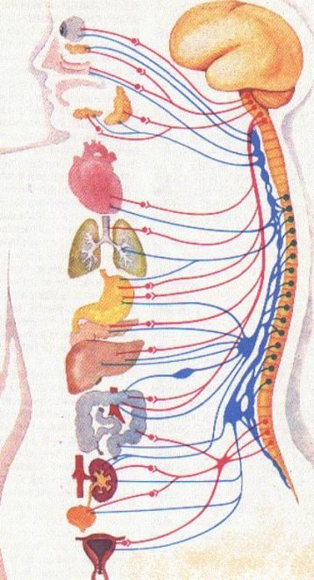
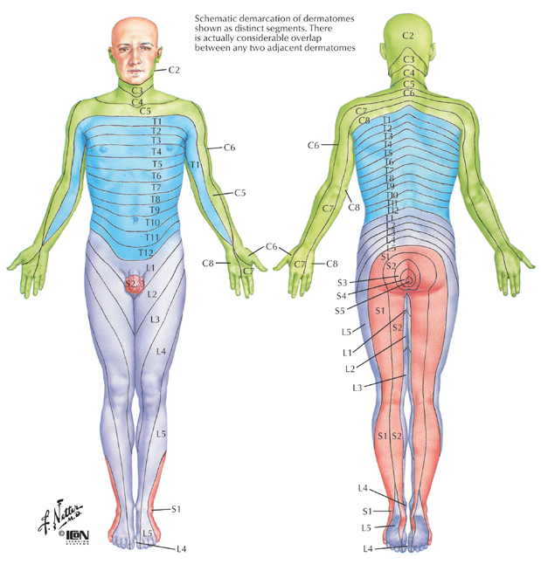
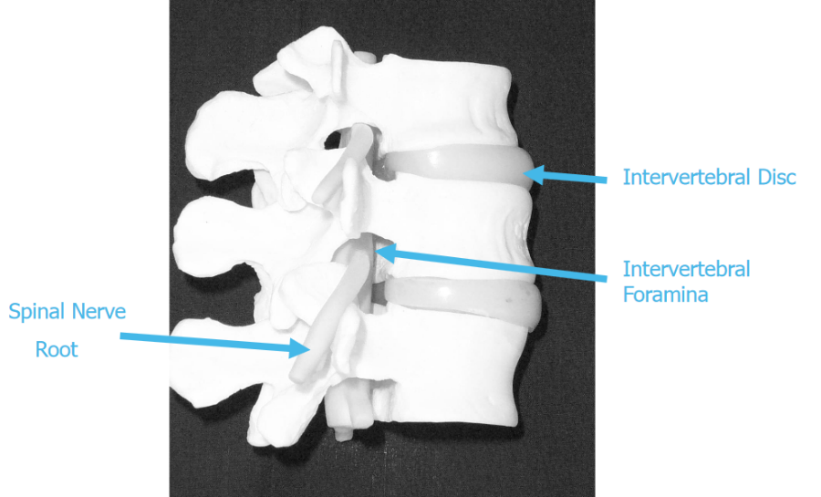
Notes:
On this slide you can see an anatomical revision of inervation of the somatic regions – dermatomes by each spinal cord segment and visceral inervation by autonomic nervous systém. On the anatomical model you can see foramina intervertebralia where the needle can be advanced in a paramedian puncture.

Slide 23
anatomy
Notes:
We continue with the revision of the anatomy. On the central image please acknowledge posterior epidural space where we try to get the needle to introduce epidural catheter for continuous epidural analgesia. On the right image you can see the final conic part of the spinal cord which continues by cauda equina. You can see that the spinal cord finishes in lumbar vertebra 2. Please note also the sacro-coccygeal ligament where the needle is advanced in case of caudal anesthesia used especially in children.

Slide 24
Spinal (subarachnoideal) anesthesia
L3-4, 4-5
usually 1-3(4) ml of LA (bupivacaine, chirocaine - isobaric or hyperbaric solution)
subarachnoid space - between arachnoid mater and pia mater, containing CSF
rapid onset
short duration
good relaxation
Notes:
In spinal anesthesia the LA is to be delivered by needle punctura into the subarachnoid space containing CSF. The puncture site is in the L3-4 intervertebra lspace most often. –usually 1-3ml of LA (bupivacaine, levobupivacaine, isobaric of hyperbaric) is applied. The onset of anesthesia is rapid, within 1-2 minutes. Duration is around 3-4 hours. This technique provide also good relaxation. This technique provide anesthesia from the puncture site to the whole body below so usually both legs, pelvis and half of the abdomen.

Slide 25
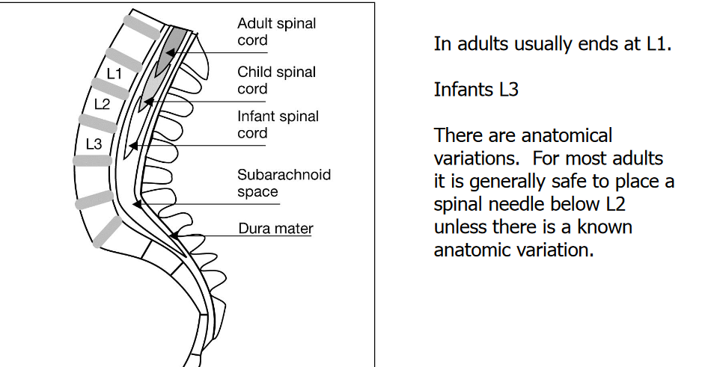
Spinal (subarachnoideal) anesthesia
Notes:
On this depiction you can see different ending site of the spinal cord based on the age of the human. Note that in infants the spinal cord ends relatively low compared to the adult.

Slide 26
Spinal needles
Notes:
Here you can see different types of spinal needles. The Quinke type is sharp and cut the tissues. The opposite is sprotte type with no sharp conus which puncture through tissues rather than cuts. It is advantageous in young women to prevent post puncture CSF leakage and post punctural headache.

Slide 27
Spinal (subarachnoideal) anesthesia
Notes:
Just to revise the anatomical knowledge, CSF is around 150ml in total in adults. Volume in subarachnoid space is 25-35ml. It is continually produced and reabsorbed. The whole volume gets replaced 3-4 times per day.

Slide 28
Epidural anesthesia
LA is administered into the epidural space
epidural space - space between ligamentum flavum and dura mater
epidural space detection method - loss of resistence (LOR) or „hanging drop“ technique
slow onset (depends on local anesthetic used) compared to spinal anesthesia
long duration compared to spinal anesthesia
Notes:
In epidural anesthesia the LA is introduced into the epidural space – in between ligamentum flavum and dura mater. The needle is inserted through the intervertebra l space i ntle place of desired anestesia or analgesia. To be sure the needle is in a correct place we use two techniques: loss of rezistance and hanging drop – both the techniques are based on the pressumption there is a negative pressure in the epidural space. Epidural anesthesia compared to spinal anesthesia has slower onset but longer duration. In case of indwelling catheter in the place the anesthesia/analgesia can last as required. Epidural technique provides anesthesia in a few dermatomes, generally 3-4 dermatomes around the puncture site.

Slide 29
Epidural anesthesia
L3-4, 4-5, Th, C region
do not forget the test dose of LA to avoid SA application and aspiration (may consider epinephrine) to avoid intravenous application
ropivacaine 0,5% 15-20 ml
bupivacaine 0,25-0,5%10-20 ml
catheter technique
Postop pain control - postoperative, chronic pain
Notes:
As mentioned epidural anesthesia can be done where ever on the spine to get desired anesthesia on the body, from cervical to caudal anesthesia. Mostly though lumbar and thoracic regions. First the aaspiration and the test dose is given to avoid subarachnoid location on the needle and complicating so called total spinal anesthesia. Even a small dose of epinephrine can be given – 5 ug to see i fthe heart rate changes. Then ropivacaine and bupivacaine are used mostly in concentrations and doses as you can see. Based on the dose the differential block is achieved – from analgesia to anesthesia and paralysis of the particular region. Leaving the catheter in plase ca nbe done even for long therm chronic pain therapy.

Slide 30
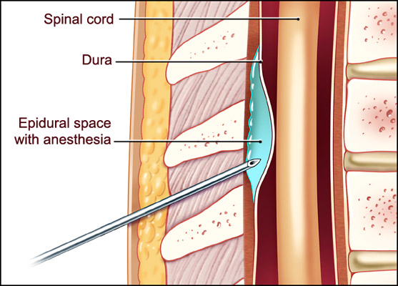
Epidural anesthesia
Notes:
On the left upeer image you can se detail of the epidural needle, so called Thouhy needle with sharp apex and large tunel. The catherer is very tiny with a internal diameter almost like a hair.

Slide 31
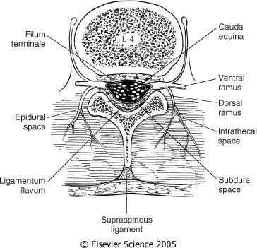
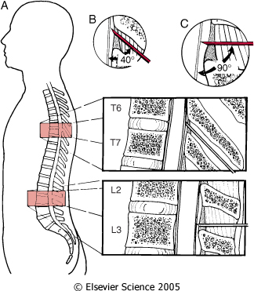
Notes:
Her you can see insertion of the needle in different angles based on the anatomical propositon of the vertebral processes.

Slide 32
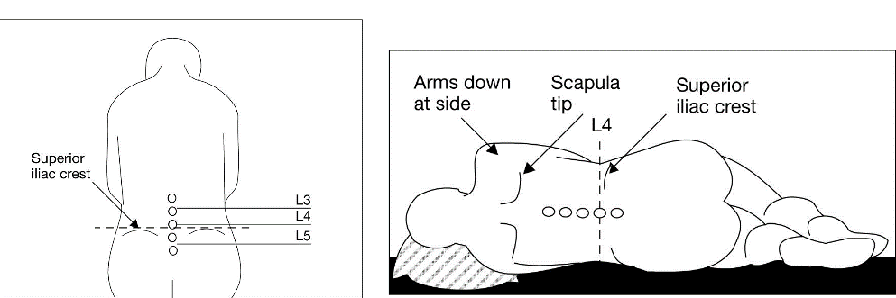
Positioning for neuraxial blocks
Notes:
The patient can lie on the side or sit to do the block. Mostly at the patient convenience. But in thoracic and cervical spaces the best positon is while sitting.

Slide 33
Caudal block
Notes:
Caudal anesthesia is used the most in children. You can easily palpate the cornual sacralia caudalia around hiatus sacralis in them. The technique is safe and efficient even for postoperative analgesia. Caudal blocks are done the most for urological surgery and orthopedics.

Slide 34
Epidural and spinal anesthesia - complications
Spinal anesthesia
hypotension
postdural puncture headache
low back pain
extensive spread of anesthesia
neurological injuries
Epidural anesthesia
hypotension, toxicity due to LA agents
accidental SA, dural puncture and headache
total spinal anesthesia, neural damage
Notes:
What are the complications of these techniques?
In spinal anesthesia hypotension is common due to the blocade of sympathetic nerves and vasodilatation in the half of the body. Postpuncture headache is when the CSF leaks out throught´big hole or multiple attempts, then even low back pain can ensue. In case of extensive spread of anesthetics a rare complication – total spinal nesthesia can occur – in this case quickly intubate the patient and give noradrenaline.
In epidural anesthesia hypotension can occur as well and due to higher doses of LA systemic toxicity can be seen. Accidentaly you can puncture dura mater with postpunctural headache. Nerves can be damaged with reckless needle advancment. Total spinal anesthesia can also occur while injecting the full epidural dose inadvertently into the subarachnoid space.

Slide 35
Peripheral nerve blocks
Notes:
Peripheral nerve blocks are done by injecting LA in a close proximity to the nerves. They are done nowadays mostly by ultrasound navigation with direct visualization of the nerve as a anatomical structure so you can see actual anatomical variability and spread of the local anesthetic around the desired structure. Sometimes the LA is injected i nthe anatomical fascial space and it is spread naturally to the nerves in the preformed anatomical space.

Slide 36
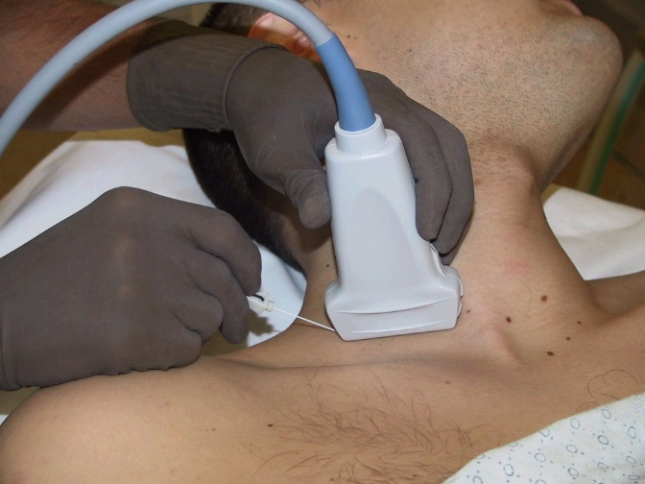
Methods of nerve detection
paresthesia
neurostimulation
ultrasound
Notes:
Ultrasound is the most reliable and safe method. Older methods are electric nerve stimulation of even blind needle insertion to supposed anatomical location and paresthesia generation. You can easily evaluate which technique is the most suitable.

Slide 37
Peripheral nerve blocks
Upper extremity
Interscalenic block
Supra-, Infraclavikular block
Axilary block
Blocks in ellbow regio
Radial nerve
Ulnar nerve
Median nerve
Wrist block
Lower extremity
Psoatic block
Femoral block, FIC block
Ischiadic block
Saphenus block
Foot block
Notes:
For upper extremity the brachial plexus is to be blocked in its anatomical course: intercalenic block, supra or infraclavicular block, axillary block, single nerve block in the antebrachium, wrist block, finger block – based on the reguired extent of the anesthesia or analgesia. You have to calculate with phrenic nerve involvment in the proximal part of the plexus.
For lower extremity we use psoatic block, femoral or femoral interfascial block, ischiadic block, popliteal block, saphenus block and foot block.

Slide 38
Peripheral nerve blocks
Thoracic wall blocks
Paravertebral block
ESP block
PECS I, II, SAP block
…
Abdominal wall blocks
TAP block
Rectus sheat block
QLB I,II,III
…
Notes:
In the chest and abdomen we use interfascial and paravertebral blocks. In the chest then pectoral blocks, serratus anterior block and intercostal blocks. In the abdomen transversus abdominal plane block, rectus sheath block and quadratus lumborum blocks.

Slide 39
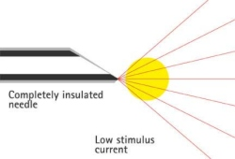
Peripheral nerve blocks - Neurostimulation
Notes:
On this slide you can see demonstration of peripheral nerve block using nerve stimulator. The electric current is decreased as the needle approaches the nerve until the lowest possible current can produce muscle twiches.

Slide 40
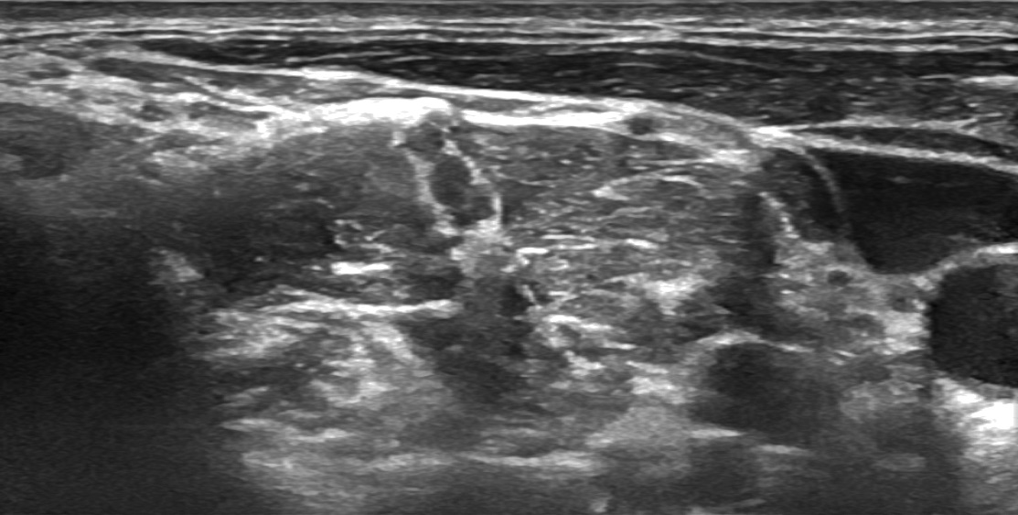
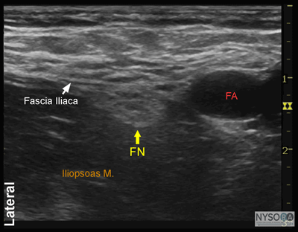
Periferní nervové blokády - Ultrasound (UGRA)
Notes:
And here you can see ultrasonographic guidance of the interscalenic block of the brachial plexus. The needle must be visualized to see the tip approaching the nerve structure. On the top right image it is a snowman like structure encircled by hyperechogenic perineurium between m. scalenus anterios and medius. On the bottom images block of the femoral nerve.

Slide 41
Bier´s intravenous anesthesia
Upper extremity
LA without cardiotoxicity (lidocain, prilocain)
Exsanguination of extremity, inflation of tourniquet, administration of LA via iv.cannula, diffusion from capilarries to nerves
Notes:
Bier blockade is an old technique of intravenous local anesthesia. It was achieved by inflation of the tourniquet on anemized arm and injeting large volume of LA into the venous systém of the arm. By diffusion all the nerves got anesthetized. This technique in not used nowadays.

Slide 42
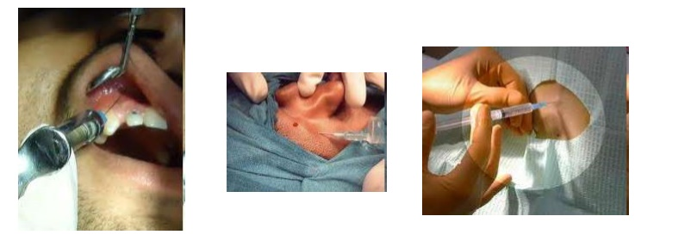
infiltration anesthesia
Intradermal or intramuscular aplication
Block of peripheral sensitive receptors
Notes:
Infiltration anesthesia is done by injecting LA around the tissues to be anesthetized. It is used by many specialities in medicine: dentistry, plastic surgery, dermatology, ENT etc.

Slide 43
Topical anesthesia
Anesthesia of mucose membranes
Quick onset
Short duration of anesthesia
Rapid intravascular absorption
Skin anesthesia (EMLA crm)
Eutectic mixture of lidocain and prilocain
Notes:
By topical anesthesia the LA diffuse through mucose membranes. This technique has rapid onset and short duration due to rapid intravascular absorption. E.g. Skin topical anesthesia is done by eutectic mixture of local anesthetics – lidocain and prolocain.

Slide 44
Coffee break ?
Klinika anesteziologie, resuscitace a intenzivní medicíny
Univerzita Karlova, Lékařská fakulta v Hradci Králové
Fakultní nemocnice Hradec Králové
Dept. of Anaesthesiology and Intensive Care Medicine
Charles University, Faculty of Medicine
University Hospital Hradec Kralove

