Slide 1
ABCDE approach
Klinika anesteziologie, resuscitace a intenzivní medicíny
Univerzita Karlova, Lékařská fakulta v Hradci Králové
Fakultní nemocnice Hradec Králové
Dept. of Anaesthesiology and Intensive Care Medicine
Charles University, Faculty of Medicine
University Hospital Hradec Kralove

Slide 2
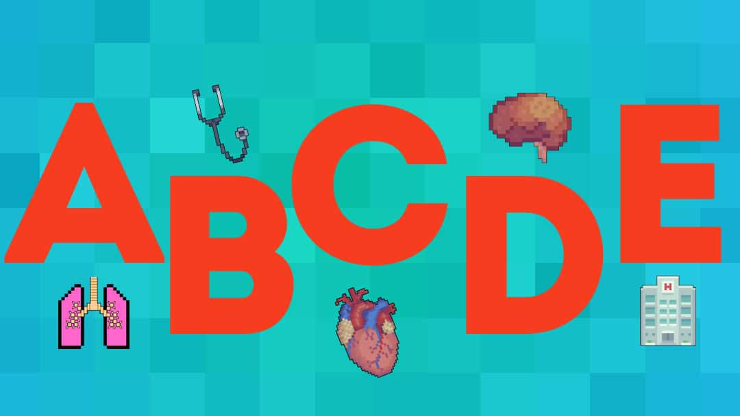
ABCDE approach
Intervene first the most life-threatening condition
Usually sequence Airway, Breathing, Circulation, Disability, Exposure

Slide 3
General principles
Use the Airway, Breathing, Circulation, Disability, Exposure (ABCDE) approach to assess and treat the patient.
Do a complete initial assessment and re-assess regularly.
Treat life-threatening problems before moving to the next part of assessment.
Assess the effects of treatment.
Recognise when you will need extra help. Call for appropriate help early.

Slide 4
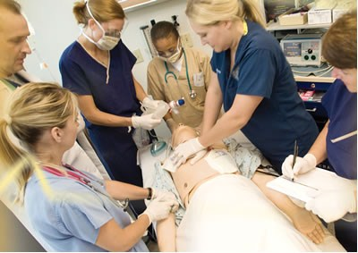
General principles
Use all members of the team.
This enables interventions (e.g. assessment, attaching monitors, intravenous access), to be undertaken simultaneously.
Communicate effectively
Use the Situation, Background, Assessment, Recommendation (SBAR) or Reason, Story, Vital signs, Plan (RSVP) approach.
The aim of the initial treatment is to keep the patient alive, and achieve some clinical improvement. This will buy time for further treatment and making a diagnosis.
Remember – it can take a few minutes for treatments to work, so wait a short while before reassessing the patient after an intervention.

Slide 5
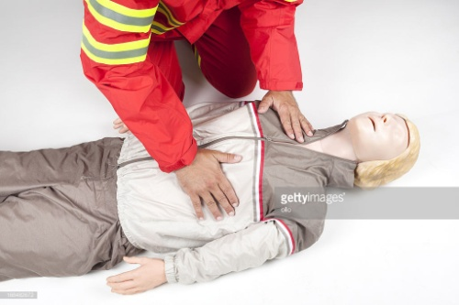
First steps
Ensure personal safety. Wear apron and gloves as appropriate.
First look at the patient in general to see if the patient appears unwell.
If the patient is awake, ask “How are you?”. If the patient appears unconscious or has collapsed, shake him and ask “Are you alright?” If he responds normally he has a patent airway, is breathing and has brain perfusion.
If he speaks only in short sentences, he may have breathing problems. Failure of the patient to respond is a clear marker of critical illness.
This first rapid ‘Look, Listen and Feel” of the patient should take about 30 s and will often indicate a patient is critically ill and there is a need for urgent help. Ask a colleague to ensure appropriate help is coming.

Slide 6
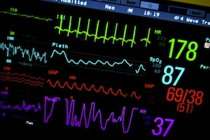
First steps
If the patient is unconscious, unresponsive, and is not breathing normally (occasional gasps are not normal) start CPR according to the resuscitation guidelines.
If you are confident and trained to do so, feel for a pulse to determine if the patient has a respiratory arrest.
If there are any doubts about the presence of a pulse start CPR.
Monitor the vital signs early. Attach a pulse oximeter, ECG monitor and a non-invasive blood pressure monitor to all critically ill patients, as soon as possible.
Insert an intravenous cannula as soon as possible. Take bloods for investigation when inserting the intravenous cannula.

Slide 7
Airway (A)
Look for the signs of airway obstruction:
Airway obstruction causes paradoxical chest and abdominal movements (‘see-saw’ respirations) and the use of the accessory muscles of respiration.
Central cyanosis is a late sign of airway obstruction. In partial obstruction, air entry is diminished and often noisy.
In the critically ill patient, depressed consciousness often leads to airway obstruction.
Treat airway obstruction as a medical emergency:
In most cases, only simple methods of airway clearance are required (e.g. airway opening manoeuvres, airways suction, insertion of an oropharyngeal or nasopharyngeal airway).
Tracheal intubation may be required when these fail.

Slide 8
Airway (A)
Give oxygen at high concentration:
Provide high-concentration oxygen using a mask with oxygen reservoir.
Ensure that the oxygen flow is sufficient (usually 15 L min⁻¹) to prevent collapse of the reservoir during inspiration.
If the patient’s trachea is intubated, give high concentration oxygen with a self-inflating bag.
In acute respiratory failure, aim to maintain an oxygen saturation of 94–96%.
In patients at risk of hypercapnic respiratory failure (see below) aim for an oxygen saturation of 88–92%.

Slide 9
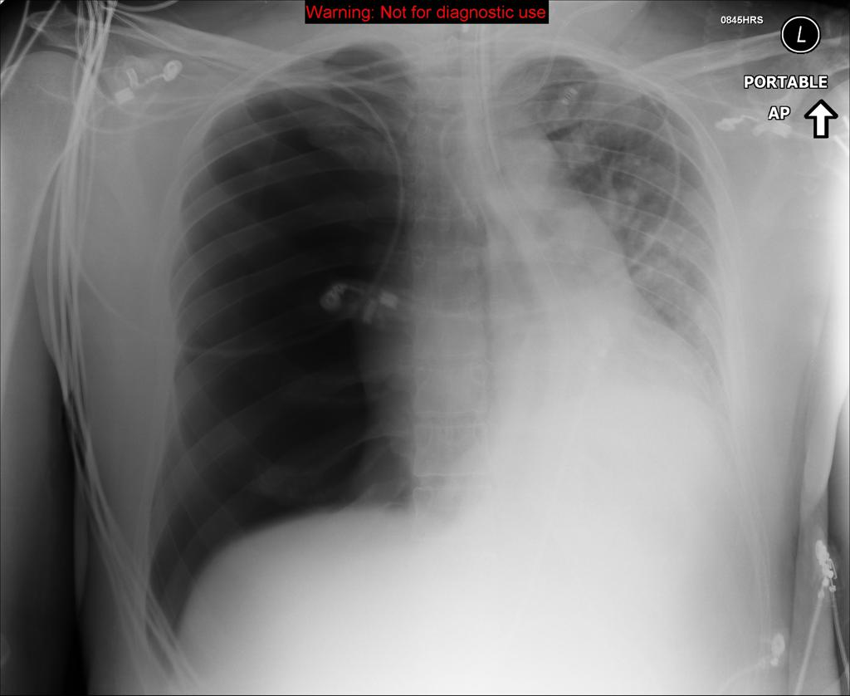
Breathing (B)
During the immediate assessment of breathing, it is vital to diagnose and treat immediately life-threatening conditions
acute severe asthma,
pulmonary oedema,
tension pneumothorax,
massive haemothorax.
(4H + 4T)

Slide 10
Breathing (B)
Look, listen and feel for the general signs of respiratory distress: sweating, central cyanosis, use of the accessory muscles of respiration, and abdominal breathing.
Count the respiratory rate (10 seconds).
Assess the depth of each breath, the pattern (rhythm) of respiration and whether chest expansion is equal on both sides.
Note any chest deformity (this may increase the risk of deterioration in the ability to breathe normally); look for a raised jugular venous pulse (JVP) (e.g. in acute severe asthma or a tension pneumothorax); note the presence and patency of any chest drains; remember that abdominal distension may limit diaphragmatic movement, thereby worsening respiratory distress.

Slide 11
Breathing (B)
Record the inspired oxygen concentration (%) and the SpO₂ reading of the pulse oximeter.
Listen to the patient’s breath sounds a short distance from his face: lower or upper airway symptoms
Percuss the chest: hyper-resonance may suggest a pneumothorax; dullness usually indicates consolidation or pleural fluid.
Auscultate the chest: bronchial breathing indicates lung consolidation with patent airways; absent or reduced sounds suggest a pneumothorax or pleural fluid or lung consolidation caused by complete obstruction.

Slide 12
Breathing (B)
Check the position of the trachea in the suprasternal notch: deviation to one side indicates mediastinal shift (e.g. pneumothorax, lung fibrosis or pleural fluid).
Feel the chest wall to detect surgical emphysema or crepitus (suggesting a pneumothorax until proven otherwise).
All critically ill patients should be given oxygen.
In COPD, high concentrations of oxygen may depress breathing (i.e. they are at risk of hypercapnic respiratory failure - often referred to as type 2 respiratory failure).
In this group, aim for a lower than normal PaO₂ and oxygen saturation. Give oxygen via a Venturi 28% mask (4 L min⁻¹) or a 24% Venturi mask (4 L min⁻¹) initially and reassess. Aim for target SpO₂ range of 88–92% in most COPD patients, but evaluate the target for each patient based on the patient’s arterial blood gas measurements during previous exacerbations (if available

Slide 13
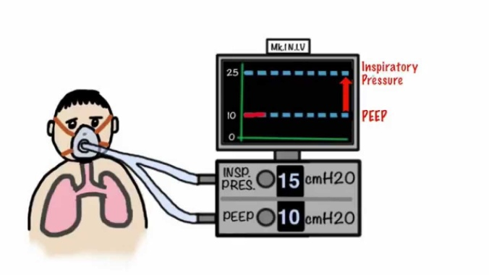
Breathing (B)
if the patient’s depth or rate of breathing is judged to be inadequate, or absent, use bag-mask or pocket mask ventilation to improve oxygenation and ventilation, whilst calling immediately for expert help.
In cooperative patients who do not have airway obstruction consider the use of non-invasive ventilation (NIV).
In patients with an acute exacerbation of COPD, the use of NIV is often helpful and prevents the need for tracheal intubation and invasive ventilation.

Slide 14
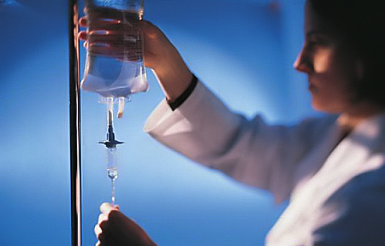
Circulation (C)
In almost all medical and surgical emergencies, consider hypovolaemia to be the primary cause of shock, until proven otherwise.
Unless there are obvious signs of a cardiac cause, give intravenous fluid to any patient with cool peripheries and a fast heart rate.
Remember that breathing problems, such as a tension pneumothorax, can also compromise a patient’s circulatory state. This should have been treated earlier on in the assessment.

Slide 15
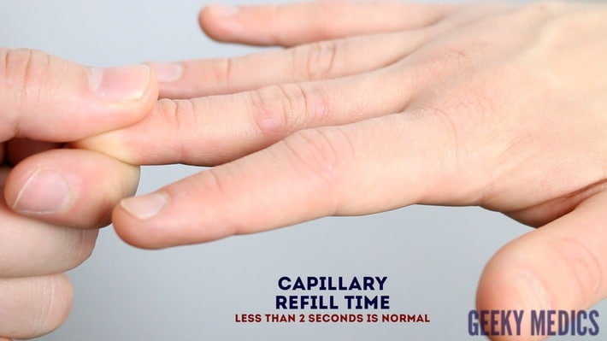
Circulation (C)
Look at the colour of the hands and digits: are they blue, pink, pale or mottled?
Assess the limb temperature by feeling the patient’s hands: are they cool or warm?
Measure the capillary refill time (CRT).
Apply cutaneous pressure for 5 s on a fingertip held at heart level (or just above) with enough pressure to cause blanching.
The normal value for CRT is usually < 2 s.
Other factors (e.g. cold surroundings, poor lighting, old age) can prolong CRT.
Assess the state of the veins: they may be underfilled or collapsed when hypovolaemia is present.

Slide 16
Circulation (C)
Count the patient’s pulse rate (or preferably heart rate by listening to the heart with a stethoscope).
Palpate peripheral and central pulses, assessing for presence, rate, quality, regularity and equality.
Measure the patient’s blood pressure.
A low diastolic blood pressure suggests arterial vasodilation (as in anaphylaxis or sepsis). A narrowed pulse pressure (difference between systolic and diastolic pressures; normally 35–45 mmHg) suggests arterial vasoconstriction (cardiogenic shock or hypovolaemia) and may occur with rapid tachyarrhythmia.

Slide 17
Circulation (C)
Auscultate the heart. Is there a murmur or pericardial rub? Are the heart sounds difficult to hear? Does the audible heart rate correspond to the pulse rate?
Look for other signs of a poor cardiac output, such as reduced conscious level and, if the patient has a urinary catheter, oliguria (urine volume < 0.5 mL kg⁻¹ h⁻¹).
Look thoroughly for external haemorrhage from wounds or drains or evidence of concealed haemorrhage (e.g. thoracic, intra-peritoneal, retroperitoneal or into gut). Intra-thoracic, intra-abdominal or pelvic blood loss may be significant, even if drains are empty.
The specific treatment of cardiovascular collapse depends on the cause, but should be directed at fluid replacement, haemorrhage control and restoration of tissue perfusion. Seek the signs of conditions that are immediately life threatening (e.g. cardiac tamponade, massive or continuing haemorrhage, septicaemic shock), and treat them urgently.

Slide 18
Circulation (C)
Insert one or more large (14 or 16 G) intravenous cannulae.
Take blood from the cannula for routine haematological, biochemical, coagulation and microbiological investigations, and cross-matching, before infusing intravenous fluid.
Give a bolus of 500 mL of warmed isotonic crystalloid solution over less than 15 min if the patient is hypotensive.
Use smaller volumes (e.g. 250 mL) for patients with known cardiac failure or trauma and use closer monitoring (listen to the chest for crackles after each bolus).
Reassess the heart rate and BP regularly (every 5 min), aiming for the patient’s normal BP or, if this is unknown, a target > 100 mmHg systolic.
If the patient does not improve, repeat the fluid challenge. Seek expert help if there is a lack of response to repeated fluid boluses.

Slide 19
Circulation (C)
If symptoms and signs of cardiac failure (dyspnoea, increased heart rate, raised JVP, a third heart sound and pulmonary crackles on auscultation) occur, decrease the fluid infusion rate or stop the fluids altogether. Seek alternative means of improving tissue perfusion (e.g. inotropes or vasopressors).
If the patient has primary chest pain and a suspected ACS, record a 12-lead ECG early.
Immediate general treatment for ACS includes:
Aspirin 300 mg, orally, crushed or chewed, as soon as possible.
Nitroglycerine, as sublingual glyceryl trinitrate (tablet or spray).
Oxygen: only give oxygen if the patient’s SpO₂ is less than 94% breathing air alone.
Morphine (or diamorphine) titrated intravenously to avoid sedation and respiratory depression.

Slide 20
Disability (D)
Common causes of unconsciousness include profound hypoxia, hypercapnia, cerebral hypoperfusion, or the recent administration of sedatives or analgesic drugs.
Review and treat the ABCs: exclude or treat hypoxia and hypotension.
Check the patient’s drug chart for reversible drug-induced causes of depressed consciousness. Give an antagonist where appropriate (e.g. naloxone for opioid toxicity).
Examine the pupils (size, equality and reaction to light).
Make a rapid initial assessment of the patient’s conscious level using the AVPU method: Alert, responds to Vocal stimuli, responds to Painful stimuli or Unresponsive to all stimuli. Alternatively, use the Glasgow Coma Scale score. A painful stimuli can be given by applying supra-orbital pressure (at the supraorbital notch).

Slide 21
Disability (D)
Measure the blood glucose to exclude hypoglycaemia using a rapid finger-prick bedside testing method.
In a peri-arrest patient use a venous or arterial blood sample for glucose measurement as finger prick sample glucose measurements can be unreliable in sick patients.
Follow local protocols for management of hypoglycaemia. For example, if the blood sugar is less than 4.0 mmol L⁻¹ in an unconscious patient, give an initial dose of 50 mL of 10% glucose solution intravenously.
If necessary, give further doses of intravenous 10% glucose every minute until the patient has fully regained consciousness, or a total of 250 mL of 10% glucose has been given. Repeat blood glucose measurements to monitor the effects of treatment. If there is no improvement consider further doses of 10% glucose. Specific national guidance exists for the management of hypoglycaemia in adults with diabetes mellitus.
Nurse unconscious patients in the lateral position if their airway is not protected.

Slide 22
Exposure (E)
examine the patient properly full exposure of the body may be necessary.
Respect the patient’s dignity and minimise heat loss.

Slide 23
Additional information
Take a full clinical history from the patient, any relatives or friends, and other staff.
Review the patient’s notes and charts:
Study both absolute and trended values of vital signs.
Check that important routine medications are prescribed and being given.
Review the results of laboratory or radiological investigations.
Consider which level of care is required by the patient (e.g. ward, ICU).
Make complete entries in the patient’s notes of your findings, assessment and treatment. Where necessary, hand over the patient to your colleagues.
Record the patient’s response to therapy.
Consider definitive treatment of the patient’s underlying condition.

